Slide 1
Critical Design Review
EE/COMPE 491W Senior Design
Team 08 (Team Boom)
4/26/2024

Slide 2
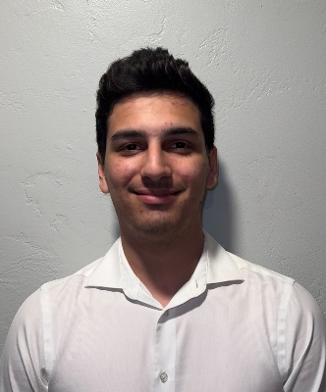
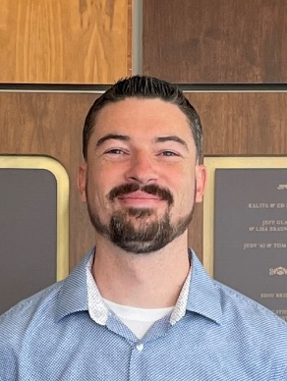
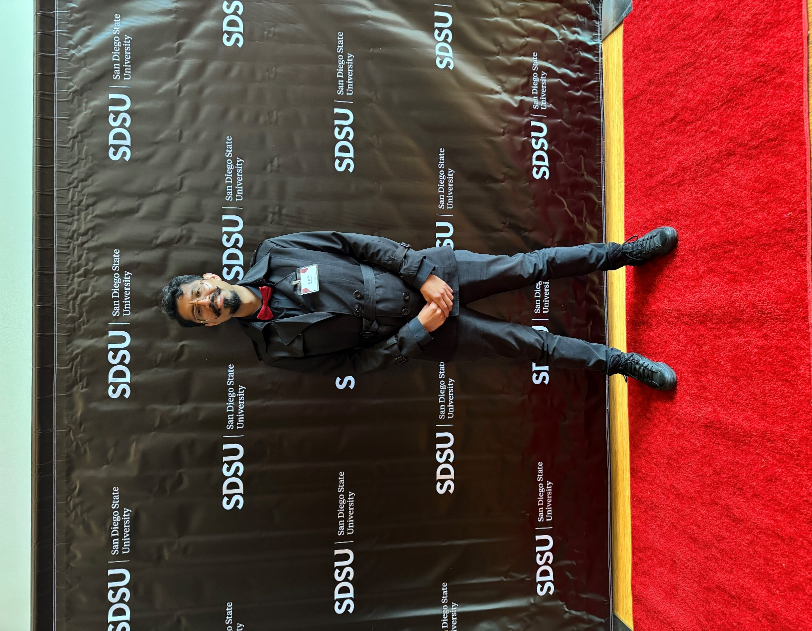


Meet the team
Antonio Balestrino
Software Lead
COMPE
Rogelio M Hernandez
Team Lead & Hardware Support
EE
Tristan Storbeck
Hardware Lead
EE
Faith Murray
Software & Graphics
COMPE
Blake Chanhmisay
Software & Testing
COMPE
Graduation Fall 2024

Slide 3

Executive Summary
Section 1: Product Overview
System Description
System Test
Section 2: Challenges & Integration
Key Technological Challenges & Strategies
Risk Analysis & Prototype Activity
Key Integration Steps
Section 3: Logistics
Work Breakdown Structure
Task List & Schedule
Cost & Financing

Slide 4
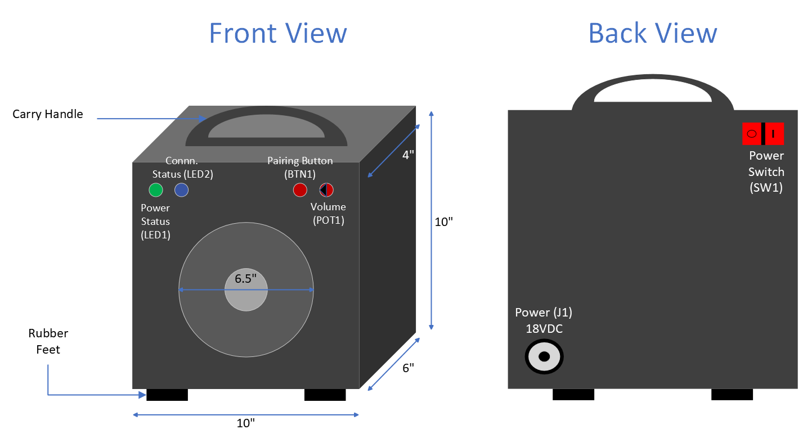
System Description

Slide 5
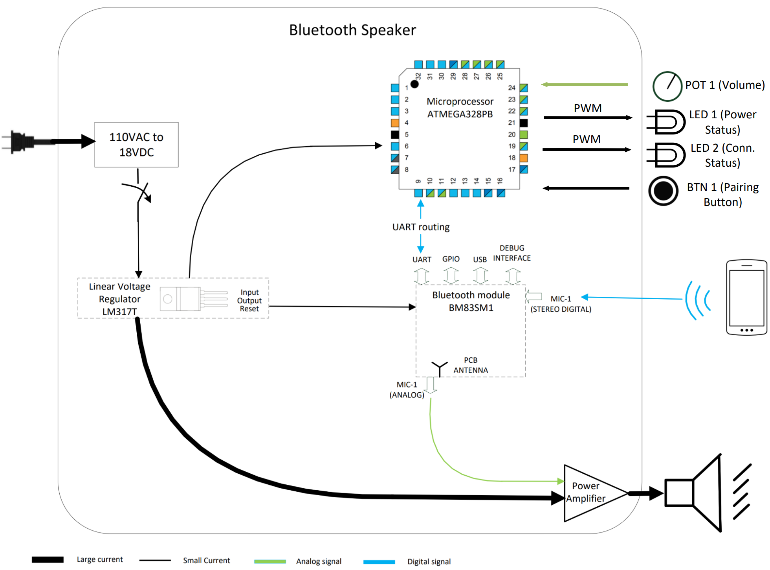
System Description

Slide 6
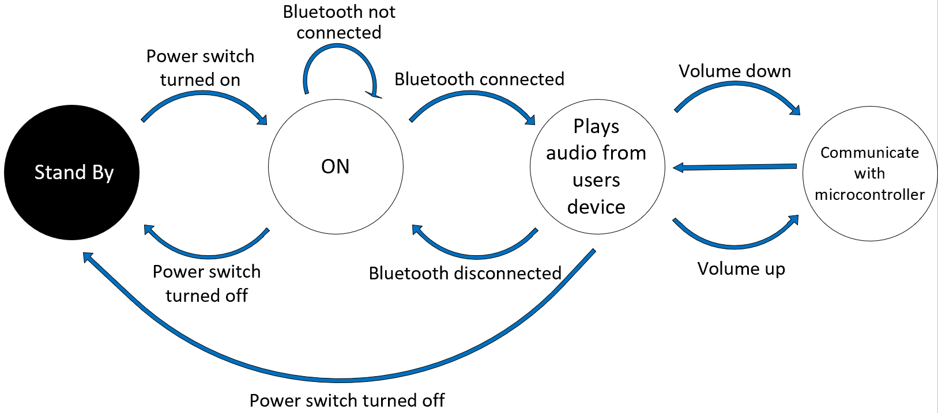
System Description – System State

Slide 7
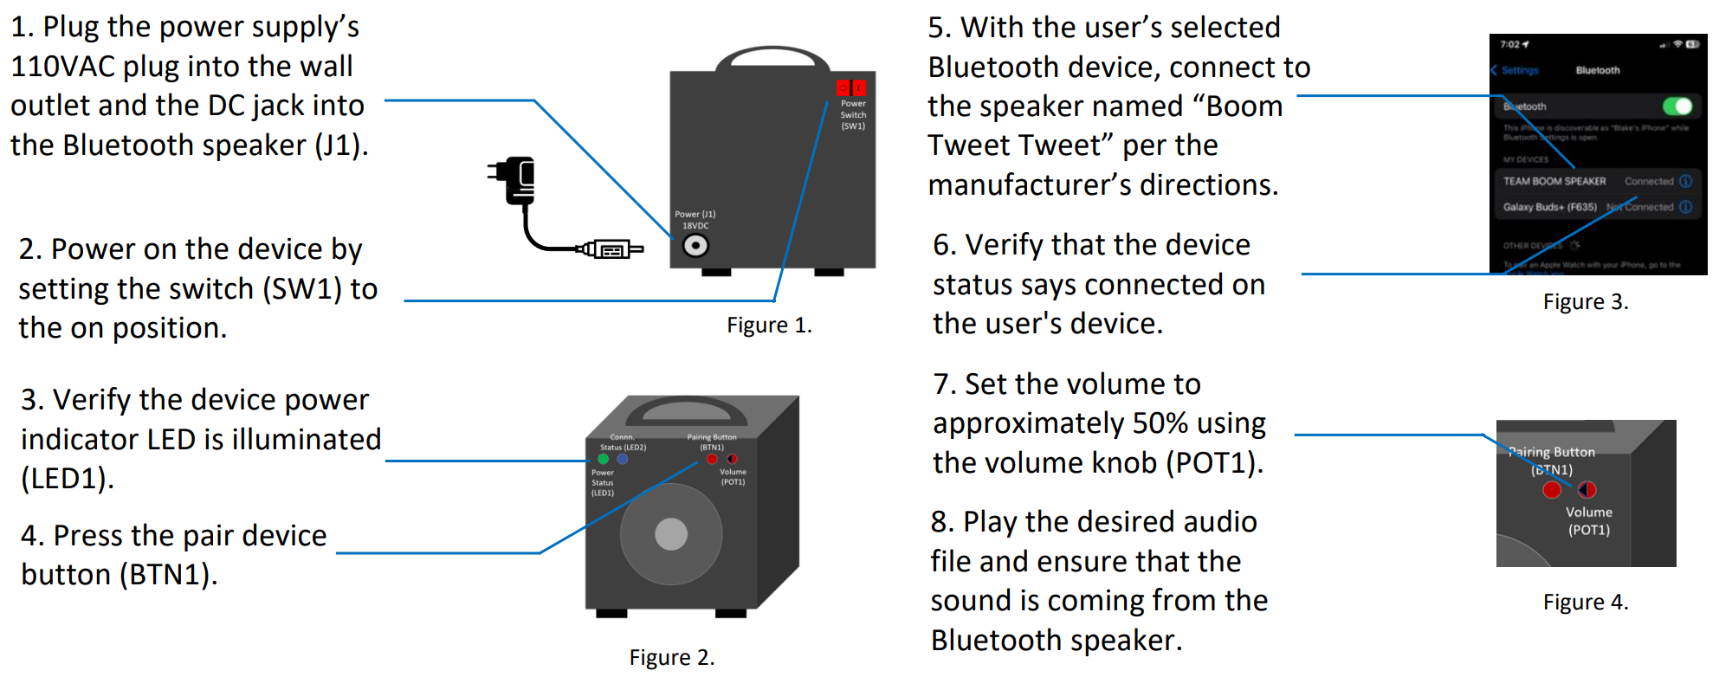
System Test

Slide 8
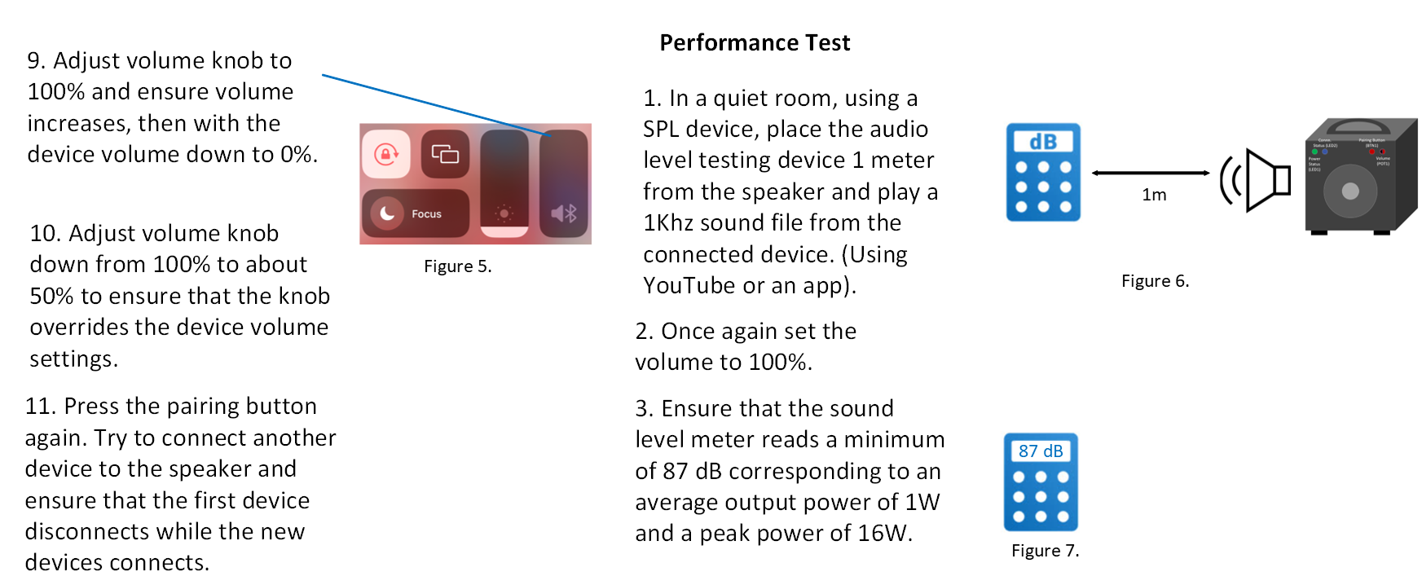
System Test

Slide 9

Section 2: Challenges & Integration
Key Technological Challenges & Strategies
Risk Analysis & Prototype Activity
Key Integration Steps

Slide 10
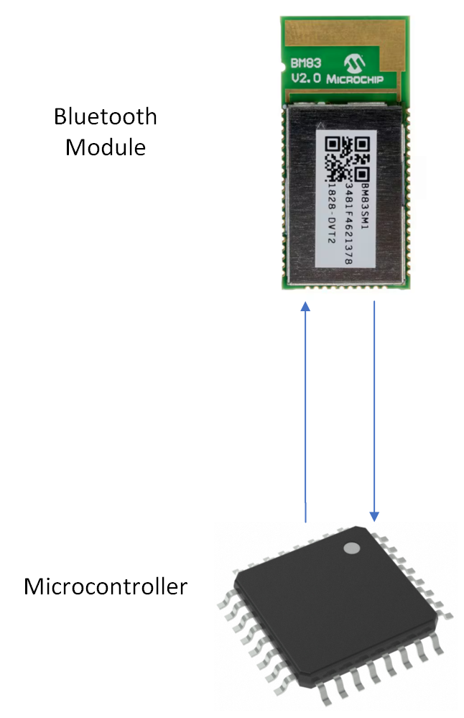
Key Technological Challenges and Strategies
UART Communication
Different logic high values between ATmega and BM83
Baud rate mismatch
Understanding BM83 UART Protocol for receiving data

Slide 11
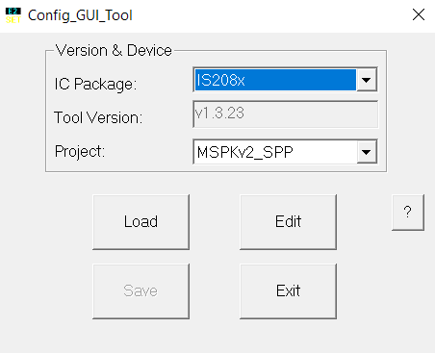
Key Technological Challenges and Strategies
Bluetooth Configuration
Which documents for configuring Bluetooth?
Which configuration mode to use for communication?
How to let PC communicate with Bluetooth Module?

Slide 12
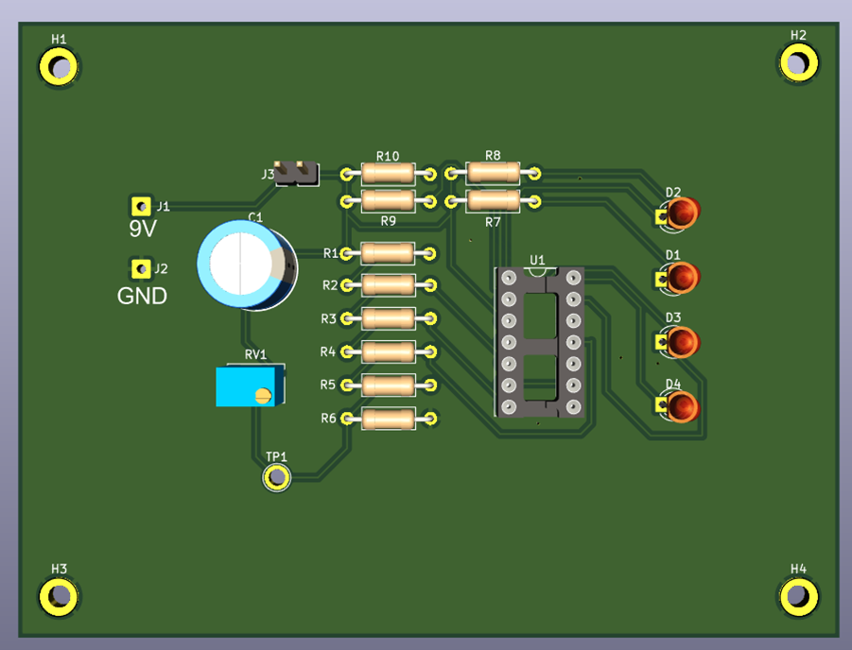
Key Technological Challenges and Strategies
PCB Design
Where to place components for optimal performance?
How to route traces efficiently?
What sizes for traces?
Sample KiCad Design Courtesy of Professor Dorr

Slide 13
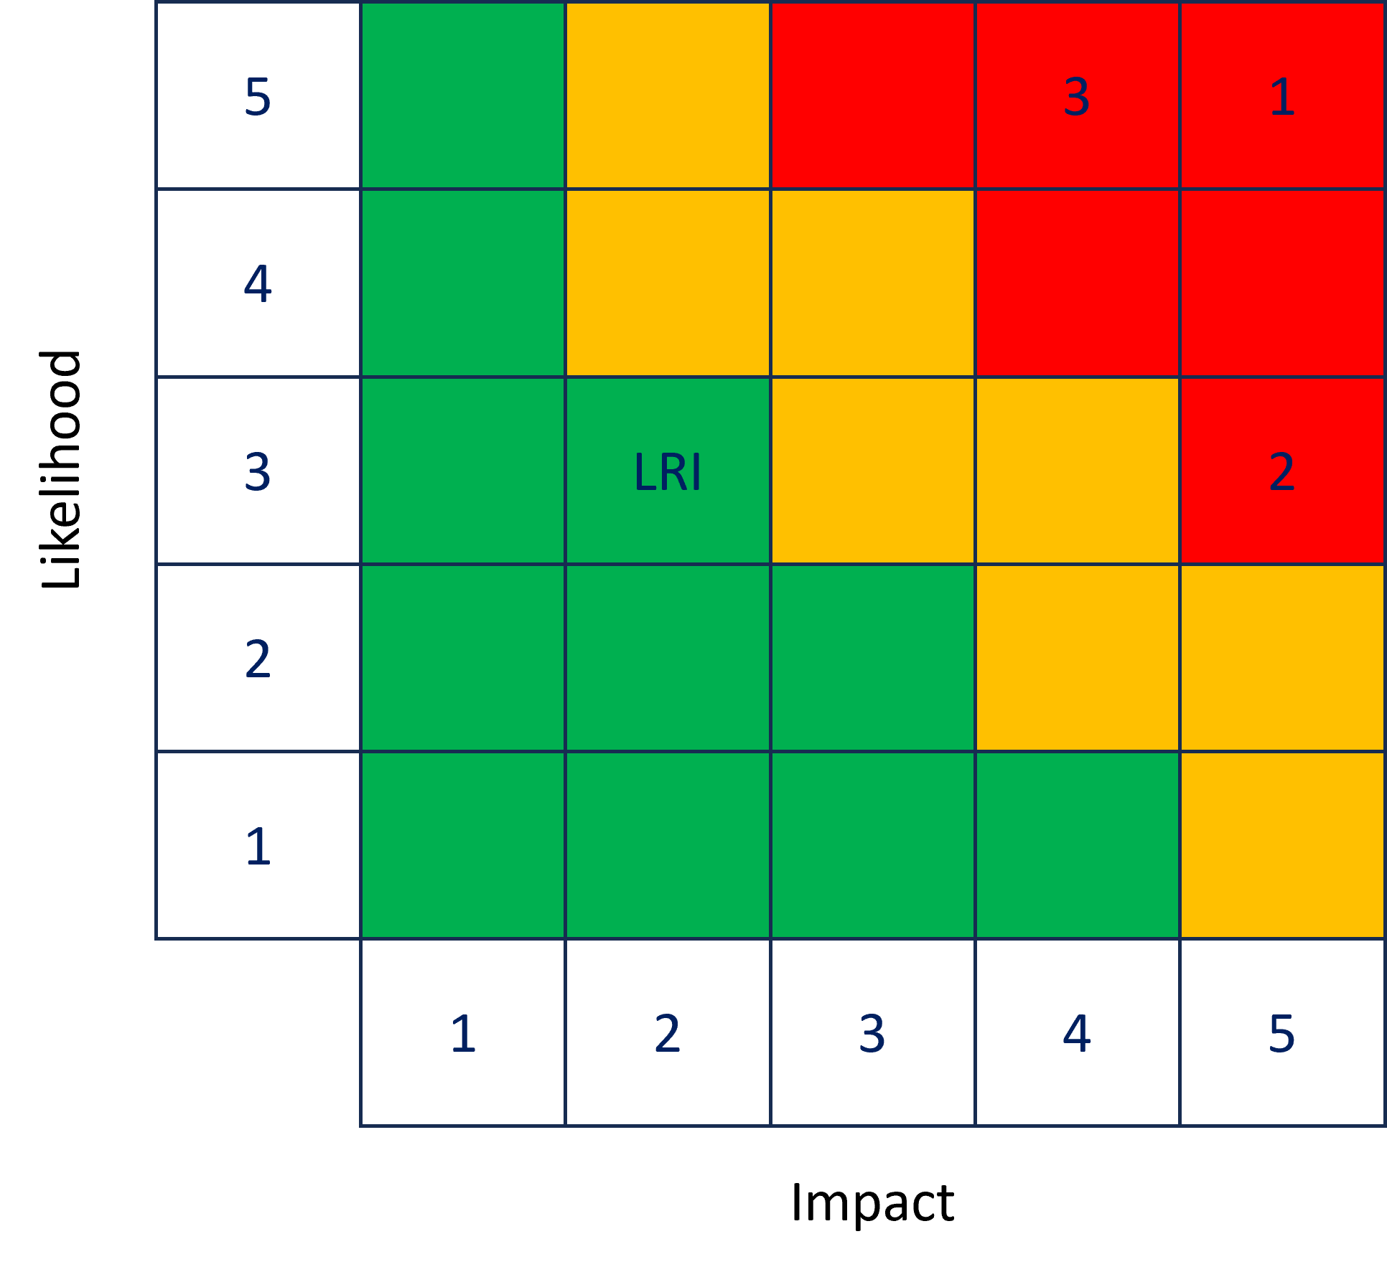
Initial Risk Analysis
Amplifier
Device Programming
Bluetooth Configuration
Low Risk Items (LRI)

Slide 14
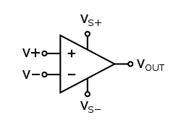
Risk 1: Amplifier
Description | Probability | Impact | Mitigation
The amplifier shall receive a voltage of 18V ± 5% to supply an 8Ω speaker with a peak power output of 16W. | With only preliminary hand calculations there is no spec or schematic of the amplifier circuit since it is a design procured from Prof. Dorr. Probability: 5 | Without a concrete design or finalized specs there will be no way to amplify the speaker’s signal. Impact: 5 | Acquired schematic & spec from Prof. Dorr.

Slide 15
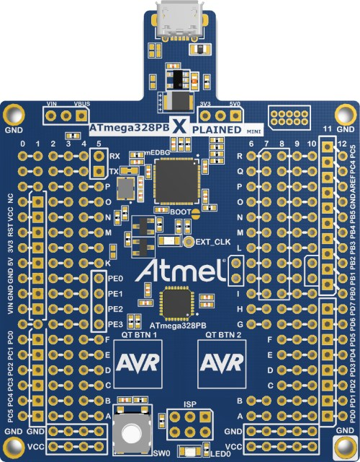
Risk 2: Device Programming
Description | Probability | Impact | Mitigation
Atmel Studio and C language to be used. We have never programmed between ICs before. | Configurations will have to be made to initialize UART, logic control, and audio processing. Must become familiar with Atmel ICE since we have never used it before. Probability: 2 | The microcontroller programmed correctly is essential for the success of the project. Must be able to send and receive commands to and from the BM83. Risk: 4 | Prototype Activity utilized the Xplained board. Was able to verify return events through LED. We will purchase the Atmel ICE debugger to program the microcontroller.

Slide 16
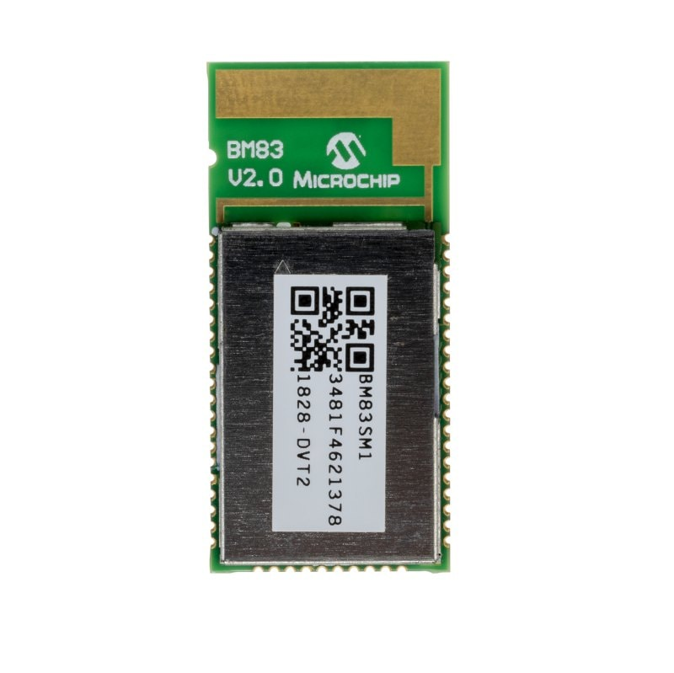
Risk 3: Bluetooth Configuration
Description | Probability | Impact | Mitigation
The Bluetooth module must be able to connect to another Bluetooth-enabled device. | End user devices have Bluetooth already configured, however the module needs a pairing command sent through UART to pair. Probability: 2 | If no connection can be made to the speaker, the project is unsuccessful. Risk: 3 | Intended to upgrade Bluetooth using OTA DFU. OTA DF​U worked initially, but due to time constraints we switched to UART configuration.

Slide 17
Low Risk Items (LRI)
Item Number | Risk | Mitigation
4 | Time Management | Everyone understands the time commitment required: 10 hrs each/weekly.
5 | Component Acquisition & Parts being damaged during shipping | Order extras & minimum 2 weeks ahead of Prototype Activities.
6 | Printed Circuit Board (PCB) Design/Layout | KiCAD Tutorials – Prof. Dorr: YouTube.
7 | SMD Soldering, ESD | Mark Bruno assistance. Grounding straps, rubber mats, ESD protective bags.
8 | Debugging | Atmel ICE.
9 | Enclosure Construction | Construct Ourselves or send to Woodshop.
10 | Total Cost | Everyone splitting costs equally.

Slide 18
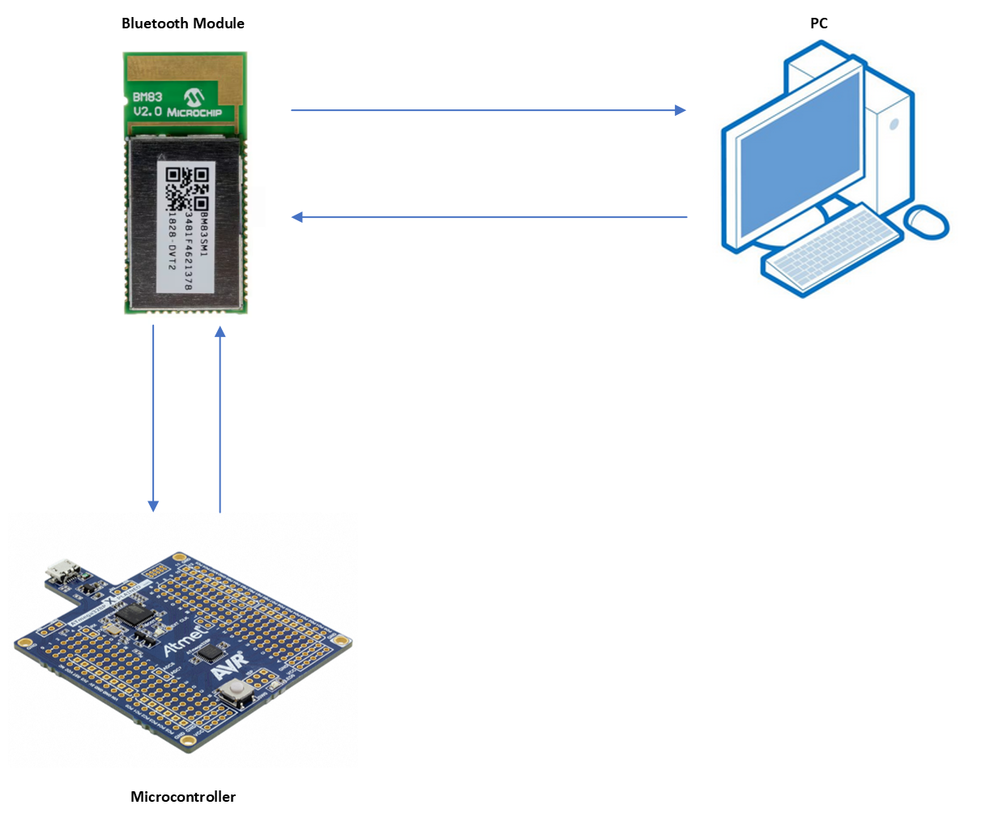
Prototyping Activity
Outcomes
Bluetooth Module paired to a device.
Successful communication from Bluetooth module to Microcontroller.
The Bluetooth Module was connected to the PC and updated using Microchip's software
Coding framework for microcontroller was done after successful confirmation of pairing
Microcontroller connected to Bluetooth Module
Commands sent from microcontroller to Bluetooth

Slide 19
Updated Risk Analysis
Amplifier
Device Programming
Bluetooth Configuration
Low Risk Items (LRI)
Likelihood
5
4
1
3
LRI
2
3
2
1
1
2
3
4
5
Impact

Slide 20
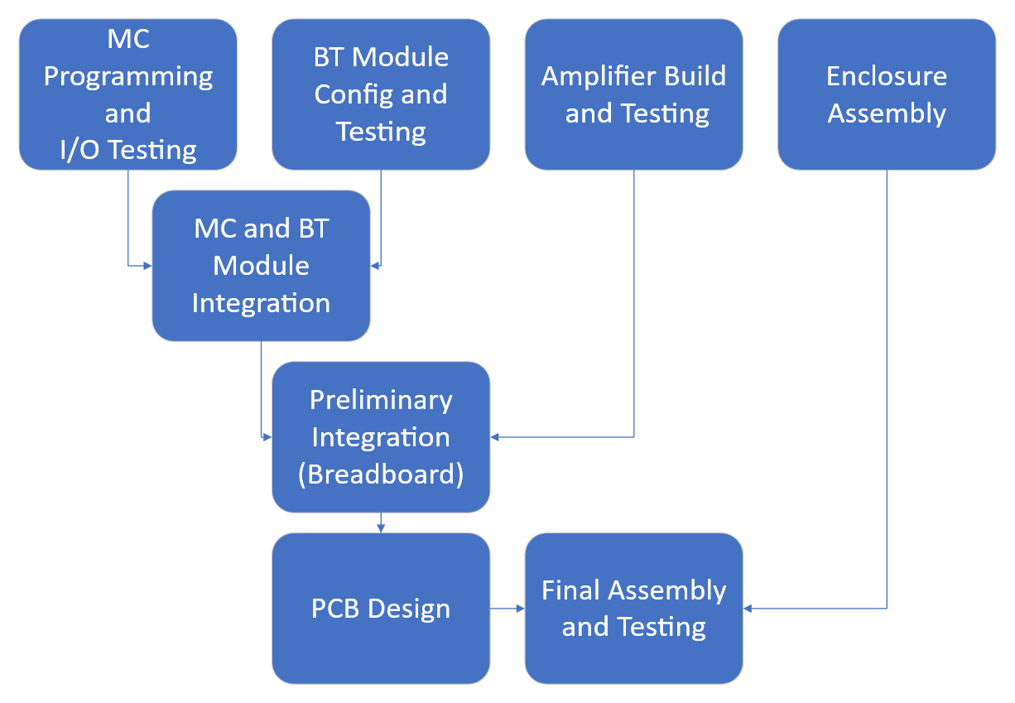
Key Integration Steps - Overview

Slide 21
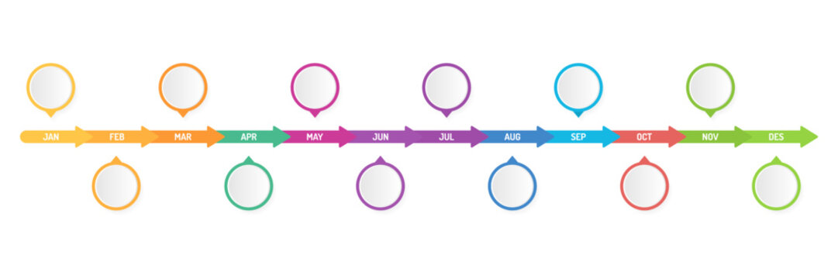
Section 3: Logistics
Work Breakdown Structure
Task List & Schedule
Cost & Financing

Slide 22
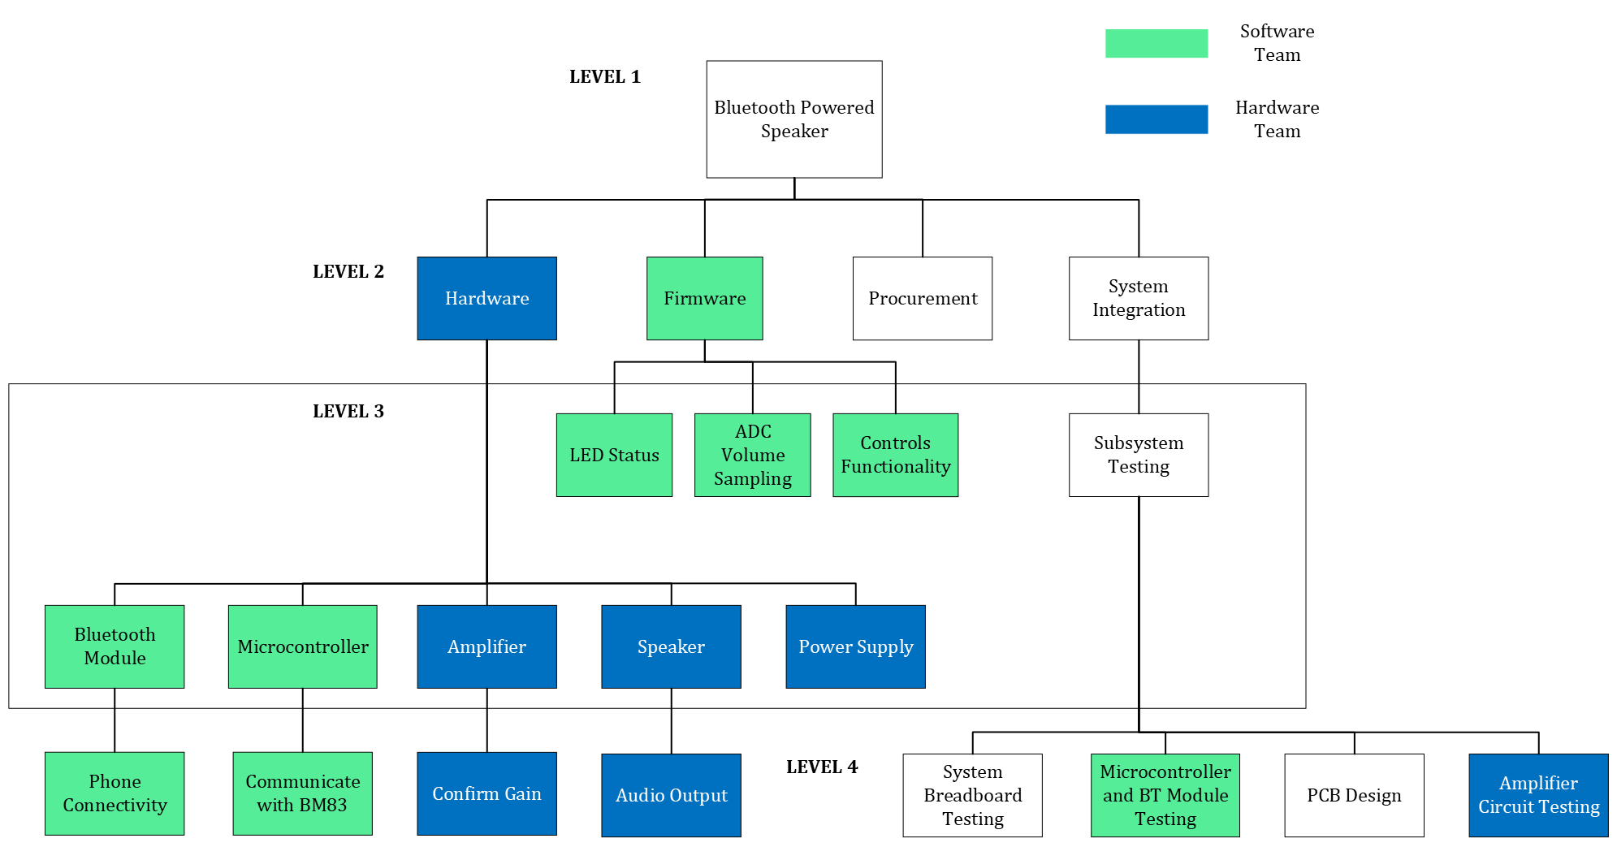
Work Breakdown Structure

Slide 23
Fall 2024 Milestones
Milestone | Description
Amplifier Testing Complete | Amplifier design is complete, tested, and ready for integration
Software Configured | Software on microcontroller and Bluetooth module is complete, I/O tested
Functional Prototype (breadboard) | Fully functional speaker on breadboard, including all inputs and outputs
PCB Designed and Functional | PCB design has been finalized, received, and tested
Enclosure Built | Speaker enclosure is complete and ready for final assembly
Final Build | Speaker is fully assembled and tested

Slide 24
Task List and Schedule
Team Boom Gantt Chart

Slide 25
Cost and Financing
Item | Quantity | Price | Total
Power Jack | 2 | $0.69 | $1.38
Microcontroller | 3 | $1.52 | $4.56
Voltage Regulator Linear | 4 | $1.87 | $7.48
Power Switch | 2 | $4.06 | $8.12
Amplifier Parts | 1 | $20.00 | $20.00
Pairing Button | 2 | $10.23 | $20.46
Atmega XMINI Eval Board | 2 | $15.47 | $30.94
Volume Potentiometer | 2 | $18.15 | $36.30

Slide 26
Cost and Financing
Item | Quantity | Price | Total
LED 2 | 2 | $18.49 | $36.98
LED 1 | 2 | $18.56 | $37.12
Bluetooth Module | 3 | $13.18 | $39.54
Power Supply | 2 | $20.71 | $41.42
Enclosure Material | 1 | $46.00 | $46.00
MISC Hardware | 1 | $50.00 | $50.00
Speaker (8 Ohms) | 2 | $39.91 | $79.82
Atmel Ice Programmer | 1 | $207.72 | $207.72
TOTAL |  |  | $667.84

Slide 27
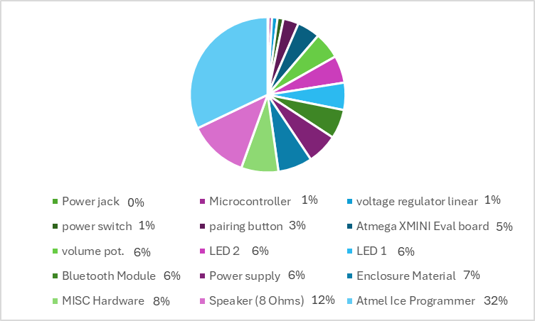
Cost and Financing – Allocated Funds

Slide 29



